Slide 1
Free to Low Cost Mobile Apps for Visually Impaired
Presenters:
Stephanie Robbins, Program Support Specialist, Assistive Technology Initiative
Kara Zirkle, IT Accessibility Coordinator, Assistive Technology Initiative
Web: http://ati.gmu.edu
Resources created by:
Rachel Kruzel, Accommodations & AT Specialist, Augsburg College DS
Visit their website for additional resources, http://www.augsburg.edu/class/groves/assistive-technology/everyone/

Slide 2
What We’ll Cover
About Apple Devices & iOS Software
Demo/Hands on Features of Built-In Accessibility
  Color Enhancement Features
  Large Text/Zoom Features
  Speak Screen/ Siri
  VoiceOver
  Braille Displays
  Free to Low Cost Apps
  Resource Links
Notes:
Introductions
About Apple Devices & iOS Software
Demo/Hands on Features of Built-In Accessibility
Color Enhancement Features
Large Text/Zoom Features
Speak Screen/ Siri
VoiceOver
Braille Displays
Resource Links
Q&A

Slide 3
Introductions
Notes:
Introductions

Slide 4
About the ATI
Services for the Mason Community
  Accessible Text, Accessible Media
  Web Accessibility
  AT Assessments
  Training
  Under Compliance, Diversity & Ethics
Services Beyond the Mason Community
  Accessible Text
  Training/Assessments
  Other services as needed
  Visit http://ati.gmu.edu
Notes:
Services for the Mason Community
Accessible Text, Accessible Media
Web Accessibility
AT Assessments
Training
Under Compliance, Diversity & Ethics
Services Beyond the Mason Community
Accessible Text
Training/Assessments
Other services as needed
Visit http://ati.gmu.edu

Slide 5
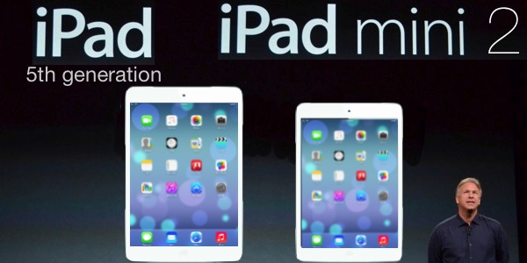
iOS Devices
iPad (Latest version: iPad Air 2, iPad Mini 3)
  http://www.apple.com/ipad/compare/
iPod Touch (Updated to Retina Display)
  http://www.apple.com/ipod-touch/
iPhone (Latest version: iPhone 6/6Plus)
  http://www.apple.com/iphone/compare/
For this demonstration, I’m using the iPad Mini 2 with updated iOS 8.1.1
https://www.apple.com/ios/what-is/
Notes:
iPad (Latest version: iPad Air 2)
http://www.apple.com/ipad/compare/
iPod Touch (Updated to Retina Display)
http://www.apple.com/ipod-touch/
iPhone (Latest version: iPhone 6)
http://www.apple.com/iphone/compare/
For this demonstration, I’m using the iPad Mini 2 with updated iOS 8.1

Slide 6
Device Pricing
iPad Air 2: 16 GB - $490-$500
64 GB - $600- $650
iPad Mini 3: 16 GB - $390- $400
64 GB - $490- $500
iPod Touch: 16 GB - $190- $200
64 GB - $290- $300
iPhone 6/6 Plus: 16 GB - $199- $299 (With carrier)
64 GB - $299- $399
Do your research and compare!
Notes:
iPad Air 2: 16 GB - $490-$500
64 GB - $600- $650
iPad Mini 3: 16 GB - $390- $400
64 GB - $490- $500
iPod Touch: 16 GB - $190- $200
64 GB - $290- $300
iPhone 6/6 Plus: 16 GB - $199- $299 (With carrier)
64 GB - $299- $399
Do your research and compare!

Slide 7
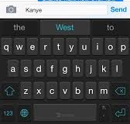
NEW iOS 8 Accessibility Features
Word Prediction- Increased efficient word prediction
Speak Screen- Speaks the screen of text when
enabled in Accessibility Settings
High Quality English Voice- Alex (Works with Speak Screen- Download in Voices Settings)
Grayscale Color Enhancement/Enhanced Zoom Features
Notes:
Word Prediction- Increased efficient word prediction
Speak Screen- Speaks the screen of text when enabled
in Accessibility Settings
High Quality English Voice: Alex (Works with Speak Screen- Download in Voices Settings)
Grayscale Color Enhancement
Enhanced Zoom features

Slide 8
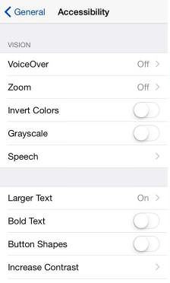
Accessibility - Color Enhancements
Navigating the Accessibility Menu
  Settings on Home Screen
  General
  Accessibility
Vision Menu
  Invert Colors
  Grayscale (NEW)
  Button Shapes
  Increase Contrast Settings
  Demo & Practice
Notes:
Navigating the Accessibility Menu
Settings on Home Screen
General
Accessibility
Vision Menu - Color Blindness
Invert Colors
Grayscale (NEW)
Button Shapes
Increase Contrast Settings

Slide 9
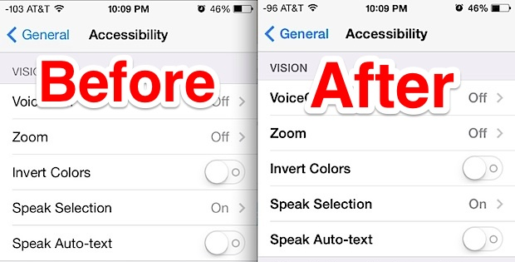
Accessibility – Large Text Enhancements
Accessibility Vision Menu:
    - Larger Text : Increase from 20pt to 56pt text in Mail, Notes, Contacts, Messages, and Calendar
    Bold Text
    Reduce Motion
Notes:
Other Settings:
- Large Text – from 20pt to 56pt text in Mail, Notes, Contacts, Messages, and Calendar
Bold Text
Reduce Motion

Slide 10
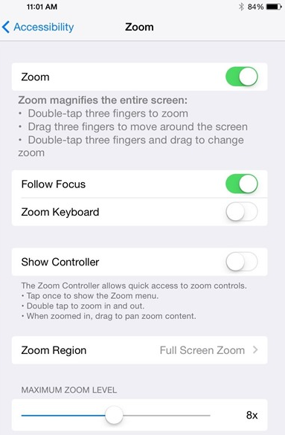
Accessibility – Vision
Vision Menu
    Zoom (Magnifies the entire screen)
      Double Tap 3 fingers to open the Zoom Menu (NEW)
        Zoom In
        Window Zoom
        Choose Filter
        Show Controller
        Zoom Slider
      Drag 3 fingers to move around the screen
Notes:
Accessibility Vision Menu
Zoom (Magnifies the entire screen)
Double Tap 3 fingers to open the Zoom Menu
Zoom In
Window Zoom
Choose Filter
Show Controller
Zoom Slider
Drag 3 fingers to move around the screen

Slide 11
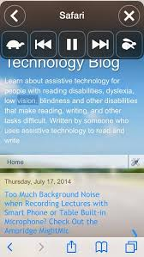
Accessibility – Speak Screen
Enabling Speak Screen (NEW)
  Swipe 2 fingers from the top of the screen down
  Speak Screen will be automatically enabled and the Speak Screen reading bar will be activated on the screen.
  Automatically start reading in any app
  with text content.
Navigating the Speak Screen Reading Bar
  Pause/Rewind/Fastforward
  Change speaking rate
  Close
Notes:
Enabling Speak Screen (NEW)
Swipe 2 fingers from the top of the screen down
Speak Screen will be automatically enabled and the Speak Screen reading bar will be activated on the screen.
Automatically start reading in any app with text content.
Navigating the Speak Screen Reading Bar
Pause/Rewind/Fastforward
Change speaking rate

Slide 12
Accessibility – Intro to Siri
Apple’s Voice Dictation Software
Example Features
  Send Messages & Emails
  Create Reminders
  Schedule Meetings
  Play Music
Siri knows what you say and what you mean!
Access Siri by pressing the home button for 3 seconds
(Example Video of Siri)
More information about Siri features: https://www.apple.com/ios/siri/
Notes:
Apple’s Voice Dictation Software
Example Features
Send Messages & Emails
Create Reminders
Schedule Meetings
Play Music
Siri knows what you say and what you mean!
Access Siri by pressing the home button for 3 seconds

Slide 13
Accessibility – VoiceOver
  Same gesture-based screen reader that is available on Mac OS
    Available on the iPad, iPhone, and iPod Touch
    Support for 30 different languages
    Very important feature: Can be enabled without sighted assistance using Siri (iOS 8)
Notes:
VoiceOver
Same gesture-based screen reader that is available on Mac OS
Available on the iPad, iPhone, and iPod Touch
Support for up to 37 different languages
Very important feature: Can be enabled without sighted assistance using a compatible screen reader and latest version of iTunes

Slide 14
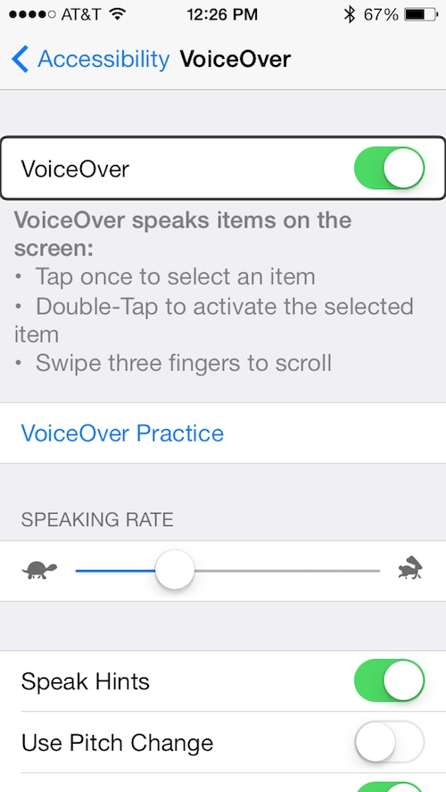
Accessibility – VoiceOver, Cont.
    - Example Features
      Easy to use gestures
      Provides access to all menus
      and apps
      Access to Email & Messages
      with character echo
      Speak Notifications
      Much more!
Notes:
Example Features
Easy to use gestures
Provides access to all menus
and apps
Access to Email & Messages
with character echo
Speak Notifications
Much more!

Slide 15
Starting and Stopping VoiceOver
2 Ways to start and stop Voice Over
1) Navigating to the Accessibility Menu
  VoiceOver (Toggle)
  Simply swipe the toggle switch to turn on VoiceOver
  2) Use Siri
  Hold down the menu button for 3 seconds
  Ask Siri to start Voice Over “Start Voice Over”
Notes:
2 Ways to start and stop Voice Over
1) Navigating to the Accessibility Menu
VoiceOver (Toggle)
Simply swipe the toggle switch to turn on VoiceOver
2) Use Siri
Hold down the menu button for 3 seconds
Ask Siri to start Voice Over “Start Voice Over”

Slide 16
VoiceOver Beginning Gestures
Tap (Touch) Gesture
  Place finger anywhere on the screen and tap
Dragging Gesture
  Simply drag your finger across the screen to encounter elements (buttons, toggle settings)
Flick Gesture
  Brush from left to right across the screen to move to items
Notes:
Tap Gesture
Place finger anywhere on the screen and tap
Hear audio cue (beeping) in an open area
Encounter an item, Voice Over will announce the item
Dragging your finger on the screen is a great way to explore
Flick Gesture
- Brush from left to right across the screen to move to items
- Flick from the left to right to go back

Slide 17
VoiceOver Gestures, Cont.
Flick Gesture
  Brush from left to right across the screen to move to items
  Flick from the left to right to go back
Double Tap Gesture
  To activate an app, double tap anywhere on the screen
  Used to activate buttons and toggle settings
Notes:
Flick Gesture
Brush from left to right across the screen to move to items
Flick from the left to right to go back
Double Tap Gesture
To activate an app, double tap anywhere on the screen
Used to activate buttons and toggle settings

Slide 18
VoiceOver Gestures, Cont.
Scrolling
  3 finger flick right and left to scroll
  3 finger flick up and down to scroll
Spelling
  1 finger flick down quickly once you are on a word
Notes:
Scrolling
3 finger flick right and left to scroll
3 finger flick up and down to scroll
Spelling
1 finger flick down quickly once you are on a word

Slide 19
VoiceOver Gesture Resources
Hadley School for the Blind: You Tube Video
http://www.youtube.com/watch?v=WKzdHH_kNcw
Audible Sight: List of Gestures
http://audiblesight.com/?page_id=1505
Using the Rotor Feature in iOS 7: You Tube Video
http://www.youtube.com/watch?v=HaU_uhZl7ZQ
Notes:
Hadley School for the Blind: You Tube Video
http://www.youtube.com/watch?v=WKzdHH_kNcw
Audible Sight: List of Gestures
http://audiblesight.com/?page_id=1505
You Tube Video: Using the Rotor Feature in iOS 7
http://www.youtube.com/watch?v=HaU_uhZl7ZQ

Slide 20
Braille Displays & iOS
Compatibility of iOS Devices with Braille Displays
  iPhone (3Gs) or later
  iPad Air & Mini
  iPod (3rd gen) or later
  Latest iOS software installed
Support for more than 40 wireless Braille displays
  Freedom Scientific
  HumanWare
  GW Micro
Support for 25 + Braille Table Languages
For complete list of supported displays & languages, visit:
https://www.apple.com/accessibility/ios/braille-display.html
Notes:
Compatibility of iOS devices with Braille Displays
iPhone (3Gs) or later
iPad Air & Mini
iPod (3rd gen) or later
Support for more than 40 wireless Braille displays
Freedom Scientific
HumanWare
GW Micro
Support for 25 + Braille Table Languages
For complete list of supported displays & languages, visit:
https://www.apple.com/accessibility/ios/braille-display.html

Slide 21
Pairing Braille Display with iOS Device
Focus 40 Blue Classic (Freedom Scientific)
  Out of the box connectivity (no extra software to install)
  USB & Bluetooth connectivity
  User friendly 8 dot keyboard
  Compact, easy to carry design
For more information on Focus 40 Braille displays, visit:
http://www.freedomscientific.com/Products/Blindness/Focus40BrailleDisplay
Notes:
Focus 40 Blue Classic (Freedom Scientific)
Out of the box connectivity (no extra software to install)
USB & Bluetooth connectivity
User friendly 8 dot keyboard
Compact, easy to carry design
For more information on Focus 40 Braille displays, visit:
http://www.freedomscientific.com/Products/Blindness/Focus40BrailleDisplay

Slide 22
Pairing Braille Display, Cont.
3 Things You Need to Know Before Pairing
    How to set the display for Bluetooth communication
    How to set the display so that it is discoverable by another device
    The Bluetooth pairing code for device
Vary from Device to Device
  HIMS & Freedom Scientific Code: 0000
  Humanware: 1234
  Contact the manufacturer for correct pairing code!
Notes:
3 Things You Need to Know Before Pairing
How to set the display for Bluetooth communication
How to set the display so that it is discoverable by another device
The Bluetooth pairing code for device
Vary from Device to Device
HIMS & Freedom Scientific Code: 0000
Humanware: 1234
Contact the manufacturer for correct pairing code!

Slide 23
Steps for Pairing Display
Make sure that VoiceOver is turned on.
2. Make sure that your display is turned on and discoverable (Open VoiceOver Braille Settings on iOS device).
3. If Bluetooth is not activated, you will be prompted to turn it on in the Braille settings.
4. Once Bluetooth is on and has found the display, select the display. You will be prompted to enter the pairing code.
5. Enter the pairing code and select OK.
Notes:
1. Make sure that VoiceOver is turned on
2. Make sure that your display is turned on and discoverable (Open VoiceOver Braille Settings on iOS Device).
3. If Bluetooth is not activated, you will be prompted to turn it on in the Braille settings.
4. Once Bluetooth is on and has found the display, select the display. You will be prompted to enter the pairing code.
5. Enter the pairing code and select OK.

Slide 24
Braille Display Resources
You Tube Pairing Video- Step by Step with iOS
https://www.youtube.com/watch?v=1A_XdJipwYo
Focus 40 Blue Classic Navigation Keystrokes:
http://support.apple.com/en-us/HT202123
Notes:
You Tube Pairing Video- Step by Step with iOS
https://www.youtube.com/watch?v=1A_XdJipwYo
Focus 40 Blue Classic Navigation Keystrokes:
http://support.apple.com/en-us/HT202123

Slide 25
AccessNote (Cost: Free)
  Notetaking tool for those who are Blind or Visually Impaired created by the American Foundation for the Blind
  App combines notetaking capabilities with the other accessibility features and functions of the iOS device
  Input notes with either QWERTY Keyboard, refreshable Braille Display
  More Information: http://goo.gl/bozjm7
  Compatibility: iOS App store & Google Play Store
Notes:
AccessNote (Cost: Free)
Notetaking tool for those who are Blind or Visually Impaired created by the American Foundation for the Blind
App combines notetaking capabilities with the other accessibility features and functions of the iOS device
Input notes with either QWERTY Keyboard, refreshable Braille Display
More Information: http://goo.gl/bozjm7
Compatibility: iOS: iPad, iPhone, iPod touch

Slide 26
TapTapSee (Cost: Free)
  Use this app to help identify everyday objects for anyone with a visual impairment or who is blind
  Double tap the screen, take a picture of the object, and hear what the object is spoken out loud
  Turn VoiceOver on to have the object description read out loud
  More Information: http://www.taptapseeapp.com/
  Compatibility: iOS 7 or later, Google Play Store
Notes:
TapTapSee (Cost: Free)
Use this app to help identify everyday objects for anyone with a visual impairment or who is blind
Double tap the screen, take a picture of the object, and hear what the object is spoken out loud
Turn VoiceOver on to have the object description read out loud
More Information: http://www.taptapseeapp.com/
Compatibility: Requires iOS 7 or later: iPad, iPhone, iPod touch; Android

Slide 27
Vision Assist (Cost: $5.99)
  Use your iDevice to become an instant handheld magnifier or CCTV
  Zoom images up to 20x
  Change display mode to match your best vision including black and white, color, highlights, contrasting colors, and smart text to enhance text
  Magnify documents, books, whiteboard or anything you see
  Compatible with VoiceOver
  More Information: http://visionassist.slinkyware.com/
  Compatibility: iOS: iPad, iPhone, iPod touch
Notes:
Vision Assist (Cost: $5.99)
Use your iDevice to become an instant handheld magnifier or CCTV
Zoom images up to 20x
Change display mode to match your best vision including black and white, color, highlights, contrasting colors, and smart text to enhance text
Magnify documents, books, whiteboard or anything you see
Compatible with VoiceOver
More Information: http://visionassist.slinkyware.com/
Compatibility: iOS: iPad, iPhone, iPod touch

Slide 28
Prizmo (Cost: $9.99)
OCR Scanning App for documents, business cards, photos and more
Export as PDF/Text file or JPG/PNG (image)
Fully accessible with Voice Over, provides voice guidance
Compatible with iPhone/iPad with iOS 8.
https://itunes.apple.com/us/app/prizmo-scanning-ocr-speech/id366791896?mt=8
Notes:
Prizmo (Cost: $9.99)
OCR Scanning App for documents, business cards, photos and more
Export as PDF/Text file or JPG/PNG (image)
Fully accessible with Voice Over, provides voice guidance
Compatible with iPhone/iPad with iOS 8.
https://itunes.apple.com/us/app/prizmo-scanning-ocr-speech/id366791896?mt=8

Slide 29
ZoomReader (Cost: $19.99)
Take picture of document, OCR, read and magnify. Need to take picture of text with onboard camera.
Compatible with iPhone 4, 4S, 5, 5C, 5S, the iPad Mini, iPad 3, iPad 4, iPad Air, the iPod Touch with 5MP Camera along with iOS 4.2 or newer.
https://itunes.apple.com/us/app/zoomreader/id414117816?mt=8
Notes:
ZoomReader (Cost: $19.99)
Take picture of document, OCR, read and magnify. Need to take picture of text with onboard camera.
Compatible with iPhone 4, 4S, 5, 5C, 5S, the iPad Mini, iPad 3, iPad 4, iPad Air, the iPod Touch with 5MP Camera along with iOS 4.2 or newer.
https://itunes.apple.com/us/app/zoomreader/id414117816?mt=8

Slide 30

    Zoom Reader DEMO
https://www.youtube.com/watch?v=3E7h3i_5rfw
Notes:
Zoom Reader demo video: https://www.youtube.com/watch?v=3E7h3i_5rfw

Slide 31
Knfb Reader (Cost: $99.00)
High quality document conversion app
Converts single and multiple page documents with a reading mode (fully accessible).
Ability to import, OCR and read image based files.
Supports multiple languages
Tap and read functions
Compatible with iOS 7 or higher on iPhone, iPad, iPod
Visit the knfb website: http://www.knfbreader.com/
Notes:
Knfb Reader (Cost: $99.00)
High quality document conversion app
Converts single and multiple page documents with a reading mode (fully accessible).
Ability to import, OCR and read image based files.
Supports multiple languages
Tap and read functions
Compatible with iOS 7 or higher on iPhone, iPad, iPod
Visit the knfb website: http://www.knfbreader.com/

Slide 32
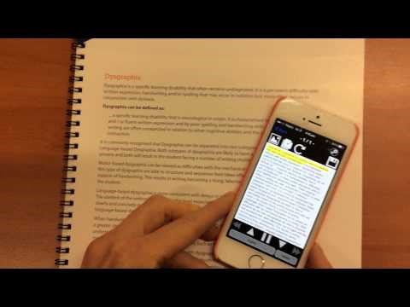
Knfb Reader Demo

Slide 33
For more App Information
Visit the ATI website: http://ati.gmu.edu/resources/at-resources/mobile-apps/
Visit the Augsburg College DS website: http://www.augsburg.edu/class/groves/assistive-technology/everyone/
Notes:
Visit the ATI website: http://ati.gmu.edu/training/assistive-technology-training/mobile-apps/
Refer to the handout that was provided

Slide 34

Q & A
Additional questions, email: ati@gmu.edu
Presentation Link:
http://ati.gmu.edu/training/presentations/
Website: http://ati.gmu.edu
Follow ATI on Twitter: @AccessibleMason
Notes:
Additional questions, email: ati@gmu.edu
Presentation Link:
http://ati.gmu.edu/training/presentations/
Website: http://ati.gmu.edu
Follow ATI on Twitter: @AccessibleMason

