Slide 1
“Utilizing Technology and Strategies to Promote Success for Students with Disabilities ”
Kara Zirkle, IT Accessibility Coordinator

Slide 2
ISSUES/challenges

Slide 3
Trending...
Increasing numbers of student’s with disabilities entering higher education
Greater implementation of online/e-learning technologies in higher education classrooms
Growing number of legal challenges/judgments in higher education by students with sensory impairments
Notes:
Read Slide

Slide 4
Challenges
Biggest challenges are in supporting students with sensory impairments…
Establish meetings with Faculty
Determine Stakeholders: Disability Services, Library, Student Services, IT, Center for Teaching, Distance Education, Legal, Academic Depts., and Compliance, Diversity and Ethics

Slide 5
Issues
Accessibility vs. Accommodation
JIT vs. Development
Time/Staffing
Inconsistency
E-Learning Technology
Non-Inclusive Practices/Awareness
Procurement
Enforcement
Costs
Legal Issues

Slide 6
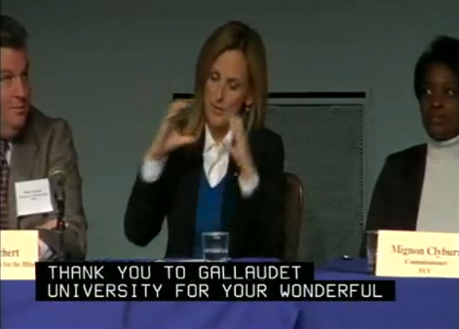
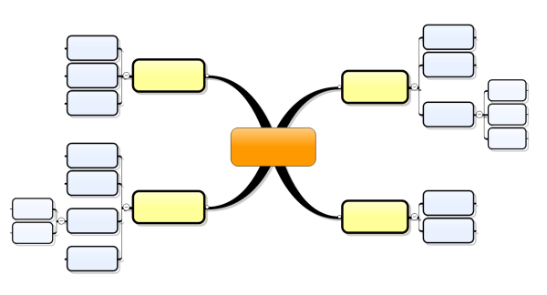
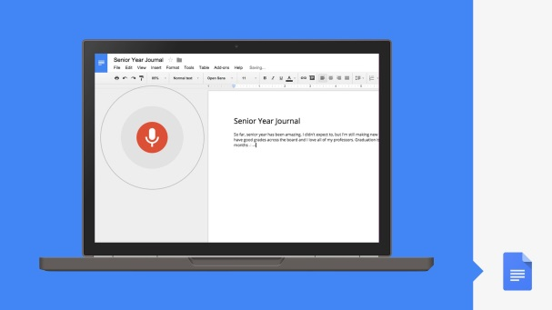
Types of Impairment and Assistive Technology
Sensory (Loss of vision, hearing, or both)
Screen readers and refreshable braille devices for people who are bling or have other print disabilities
Open or closed captioning for people who are deaf
Learning/Cognitive
Tools for organizations
Physical
Alternatives input tools, such as speech-to-text software, for people who cannot use a computer mouse
Notes:
Notes
I have listed 3 classifications here..,while there’s certainly a great deal of variation that exists under these 3 classifications, they do broadly cover much of what we are discussing here today.
When we discuss inaccessible EIT, make no mistake that 99% of the discussion (from a legal standpoint) centers around equivalent access for individuals with some degree of vision and/or hearing loss...Now, there’s only one case that I can think of which actually involved individuals with learning impairments (that was UC Berkeley and involved more timely access to printed materials in alternative formats like Braille, audio, or large print)...
So, if we move beyond thinking about the discussion in terms of disability and more about the types of assistive technology that an individual uses in order to access a computer, things start to make a bit more sense.
How instructional materials and/or our electronic resources are designed play a significant role in one’s ability to access information or participate in the programs or services that we offer...
If I am blind, I need a screen reader to access a computer and to read electronic documents
If I am deaf or hard of hearing, I need captions and transcripts for audio and video
If I have a learning impairment, I benefit from information being presented in a consistent manner and chunked so as to allow me an easier time processing that information
If I have a physical impairment which impacts my ability to use a mouse or a keyboard, I also benefit from how a document or website is structured since I too would require an alternative means for accessing a computer.

Slide 7
Read and Write Demo
E.g. Imagine the possibilities if all students had access to technology like this, not just those with disabilities …..
Notes:
Notes
Video is provided by TextHelp

Slide 8
Would you consider a robot AT?

Slide 9
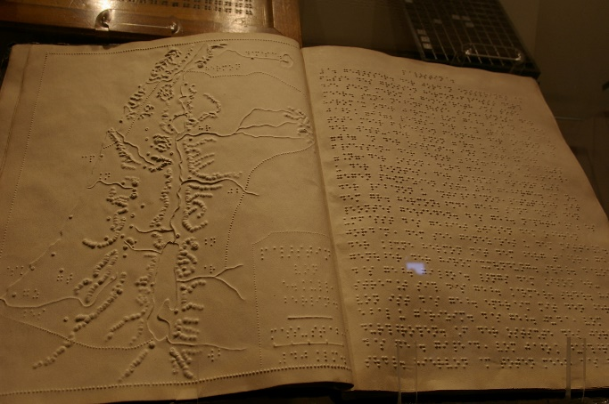
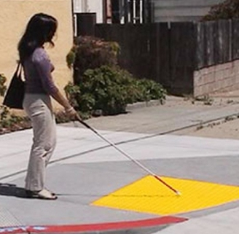
Accessibility vs. Accommodation
Accessibility
Accommodation

Slide 10
What is Fueling the Fire? Lawsuits ….
CU-Boulder (2015)
Harvard/MIT – EdX (2015) – Settled Mar 2015*
Univ. of Phoenix (2015)
Univ. of Miami-Ohio (2014/2015)*
Univ. of Cincinnati (2014)*
Univ. of Montana (2014)*
Youngstown State (2014)*
Louisiana Tech (2013)
SCTCS (2013)*
Penn State (2011)
Asterisk (*) refers to cases that reference inaccurate captions and/or video with no audio descriptions on websites and in online courses

Slide 11
Strategies

Slide 12
Communication/Collaboration
Early communication with faculty members that will have a student with a sensory impairment in their courses
Training with Academic Units/Depts./Instructional Designers
Identify/Create Accessibility Liaisons for each College/School
Collaborate with Office of Distance Education
Collaborate with Library (AT Labs, e-Reserves, Captioning)
Encourage Basic Design Considerations (captioning, accessible document design) and free or built-in tools for testing/creating.
Notes:
1 – ODS sends email at beginning of each semester
2 – Training
3 – Next slide
4 – Collaboration with Office of Distance Education

Slide 13
Recommendations
Establish a minimum set of technical standards (e.g., captioning of videos, labeling of images in electronic documents) with respect to the accessibility of e-learning and information technologies used in Mason classrooms.
Encourage inclusive course design practices amongst administration, academic departments, faculty/staff, libraries, and IT.
Ensure equivalent access to all online courses by improving faculty training and adding accessibility as part of the course review process.
Improve strategies for marketing and promoting the design, development, and purchase of accessible e-learning and information technologies.
Consistently incorporate accessibility language into contracts and software license agreements to ensure that University remains in compliance with guidelines established in Section 508 of the Rehabilitation Act of 1973 and WCAG 2.0.
Make available support and funding for enterprise-wide e-learning and information technology solutions that make it easier for faculty, staff, and academic departments to comply with disability legislation.

Slide 14
Baseline Design Considerations/Training Resources

Slide 15
Baseline Design Considerations for Accessible IT Resources
Visual:
Provide descriptions for all meaningful graphics (images, charts, graphs, SmartArt, objects)
Provide descriptions for videos where visual content is important to understanding subject matter.
Using headers to mark-up tables or frames (for websites)
Choose applications that support keyboard navigation and are compatible with screen readers
Hearing:
Provide captions all videos
Provide transcripts for audio only
Cognitive, Neurological:
Use consistent navigation, tab order, appropriate language level

Slide 16
Guide to Creating Accessible Electronic Materials
This JIT training resource provides faculty/staff with step-by-step instructions on ensuring that their electronic documents/videos are accessible to individuals with disabilities.
http://ati.gmu.edu/wp-content/uploads/Guide-to-Creating-Accessible-Electronic-Materials-7-MB-pdf.pdf

Slide 17
Mobile

Slide 18
Accessibility/User Impact in Mobile Devices
Blind
Keyboard/accessible touchscreen
Name, role, state, and properties
Dynamically updating content
Low vision
Visual focus, size of content
Color and contrast
Complexity of layout/size of content
Motor Impairment
Touch-screen/D-pad access, visual focus
Alternative input, one handed operation
Reading Disabilities
Complexity/distractions of page
Consistent use of icons and text
Spacing, color and size of elements
Dynamically updating content
Photosensitive Epilepsy
Blinking and moving content
Deaf/Hard of hearing:
Use of multimedia and audio content
Auditory feedback (sound notifications)

Slide 19
Mobile Apps

Slide 20
AccessNote (Cost: Free)
Notetaking tool for those who are Blind or Visually Impaired created by the American Foundation for the Blind
App combines notetaking capabilities with the other accessibility features and functions of the iOS device
Input notes with either QWERTY Keyboard, refreshable Braille Display
More Information: http://goo.gl/bozjm7
Compatibility: iOS App store & Google Play Store
Notes:
AccessNote (Cost: Free)
Notetaking tool for those who are Blind or Visually Impaired created by the American Foundation for the Blind
App combines notetaking capabilities with the other accessibility features and functions of the iOS device
Input notes with either QWERTY Keyboard, refreshable Braille Display
More Information: http://goo.gl/bozjm7
Compatibility: iOS: iPad, iPhone, iPod touch

Slide 21
TapTapSee (Cost: Free)
Use this app to help identify everyday objects for anyone with a visual impairment or who is blind
Double tap the screen, take a picture of the object, and hear what the object is spoken out loud
Turn VoiceOver on to have the object description read out loud
More Information: http://www.taptapseeapp.com/
Compatibility: iOS 7 or later, Google Play Store
Notes:
TapTapSee (Cost: Free)
Use this app to help identify everyday objects for anyone with a visual impairment or who is blind
Double tap the screen, take a picture of the object, and hear what the object is spoken out loud
Turn VoiceOver on to have the object description read out loud
More Information: http://www.taptapseeapp.com/
Compatibility: Requires iOS 7 or later: iPad, iPhone, iPod touch; Android

Slide 22
Vision Assist (Cost: $5.99)
Use your iDevice to become an instant handheld magnifier or CCTV
Zoom images up to 20x
Change display mode to match your best vision including black and white, color, highlights, contrasting colors, and smart text to enhance text
Magnify documents, books, whiteboard or anything you see
Compatible with VoiceOver
More Information: http://visionassist.slinkyware.com/
Compatibility: iOS: iPad, iPhone, iPod touch
Notes:
Vision Assist (Cost: $5.99)
Use your iDevice to become an instant handheld magnifier or CCTV
Zoom images up to 20x
Change display mode to match your best vision including black and white, color, highlights, contrasting colors, and smart text to enhance text
Magnify documents, books, whiteboard or anything you see
Compatible with VoiceOver
More Information: http://visionassist.slinkyware.com/
Compatibility: iOS: iPad, iPhone, iPod touch

Slide 23
Prizmo (Cost: $9.99)
OCR Scanning App for documents, business cards, photos and more
Export as PDF/Text file or JPG/PNG (image)
Fully accessible with Voice Over, provides voice guidance
Compatible with iPhone/iPad with iOS 8 and higher.
https://itunes.apple.com/us/app/prizmo-scanning-ocr-speech/id366791896?mt=8
Notes:
Prizmo (Cost: $9.99)
OCR Scanning App for documents, business cards, photos and more
Export as PDF/Text file or JPG/PNG (image)
Fully accessible with Voice Over, provides voice guidance
Compatible with iPhone/iPad with iOS 8.
https://itunes.apple.com/us/app/prizmo-scanning-ocr-speech/id366791896?mt=8

Slide 24
ZoomReader (Cost: $19.99)
Take picture of document, OCR, read and magnify. Need to take picture of text with onboard camera.
https://itunes.apple.com/us/app/zoomreader/id414117816?mt=8
Notes:
ZoomReader (Cost: $19.99)
Take picture of document, OCR, read and magnify. Need to take picture of text with onboard camera.
Compatible with iPhone 4, 4S, 5, 5C, 5S, the iPad Mini, iPad 3, iPad 4, iPad Air, the iPod Touch with 5MP Camera along with iOS 4.2 or newer.
https://itunes.apple.com/us/app/zoomreader/id414117816?mt=8

Slide 25
Zoom Reader DEMO
https://www.youtube.com/watch?v=3E7h3i_5rfw
Notes:
Zoom Reader demo video: https://www.youtube.com/watch?v=3E7h3i_5rfw

Slide 26
Knfb Reader (Cost: $99.00)
High quality document conversion app
Converts single and multiple page documents with a reading mode (fully accessible).
Ability to import, OCR and read image based files.
Supports multiple languages
Tap and read functions
Compatible with iOS 7 or higher on iPhone, iPad, iPod
Visit the knfb website: http://www.knfbreader.com/
Notes:
Knfb Reader (Cost: $99.00)
High quality document conversion app
Converts single and multiple page documents with a reading mode (fully accessible).
Ability to import, OCR and read image based files.
Supports multiple languages
Tap and read functions
Compatible with iOS 7 or higher on iPhone, iPad, iPod
Visit the knfb website: http://www.knfbreader.com/

Slide 27
Knfb Reader Demo
Notes:
http://youtu.be/-EjtpBKcCcg

Slide 28
For more App Information
Visit the ATI website: http://ati.gmu.edu/training/assistive-technology-training/mobile-apps/
Refer to the handout that is on our website: http://ati.gmu.edu/training/presentations/
Notes:
Visit the ATI website: http://ati.gmu.edu/training/assistive-technology-training/mobile-apps/
Refer to the handout that was provided

Slide 29
Next Steps
Create Workflow
Find key stakeholders (DE, Library, Instructional Designers, etc.)
Start or continuing tracking data such as websites, media, databases, etc. find new areas for tracking
All options on table!
Create campus buy-in
Educate
Train targeted areas to help build allies
Locate and advertise everything accessibility in one place
Improve success
Survey students and staff
Start or keep testing for accessibility

Slide 30
iOS Accessibility
VoiceOver
SpeakScreen
Siri
Dictation
Zoom
Font Adjustments
Invert Colors and Grayscale
AssistiveTouch
Switch Control
Touch Accommodations
Predictive Text
Guided Access
Keyboard Shortcuts
Safari Reader
Dictionary

Slide 31
VoiceOver Gesture Resources
Hadley School for the Blind: You Tube Video
http://www.youtube.com/watch?v=WKzdHH_kNcw
Audible Sight: List of Gestures
http://audiblesight.com/?page_id=1505
Using the Rotor Feature in iOS 7: You Tube Video
http://www.youtube.com/watch?v=HaU_uhZl7ZQ
Notes:
Hadley School for the Blind: You Tube Video
http://www.youtube.com/watch?v=WKzdHH_kNcw
Audible Sight: List of Gestures
http://audiblesight.com/?page_id=1505
You Tube Video: Using the Rotor Feature in iOS 7
http://www.youtube.com/watch?v=HaU_uhZl7ZQ

Slide 32
Braille Displays & iOS
Compatibility of iOS Devices with Braille Displays
iPhone (3Gs) or later
iPad Air & Mini
iPod (3rd gen) or later
Latest iOS software installed
Support for more than 40 wireless Braille displays
Freedom Scientific
HumanWare
GW Micro
Support for 25 + Braille Table Languages
For complete list of supported displays & languages, visit:
https://www.apple.com/accessibility/ios/braille-display.html
Notes:
Compatibility of iOS devices with Braille Displays
iPhone (3Gs) or later
iPad Air & Mini
iPod (3rd gen) or later
Support for more than 40 wireless Braille displays
Freedom Scientific
HumanWare
GW Micro
Support for 25 + Braille Table Languages
For complete list of supported displays & languages, visit:
https://www.apple.com/accessibility/ios/braille-display.html

Slide 33
Pairing Braille Display with iOS Device
Focus 40 Blue Classic (Freedom Scientific)
Out of the box connectivity (no extra software to install)
USB & Bluetooth connectivity
User friendly 8 dot keyboard
Compact, easy to carry design
For more information on Focus 40 Braille displays, visit:
http://www.freedomscientific.com/Products/Blindness/Focus40BrailleDisplay
Notes:
Focus 40 Blue Classic (Freedom Scientific)
Out of the box connectivity (no extra software to install)
USB & Bluetooth connectivity
User friendly 8 dot keyboard
Compact, easy to carry design
For more information on Focus 40 Braille displays, visit:
http://www.freedomscientific.com/Products/Blindness/Focus40BrailleDisplay

Slide 34
Pairing Braille Display, Cont.
3 Things You Need to Know Before Pairing
How to set the display for Bluetooth communication
How to set the display so that it is discoverable by another device
The Bluetooth pairing code for device
Vary from Device to Device
HIMS & Freedom Scientific Code: 0000
Humanware: 1234
Contact the manufacturer for correct pairing code!
Notes:
3 Things You Need to Know Before Pairing
How to set the display for Bluetooth communication
How to set the display so that it is discoverable by another device
The Bluetooth pairing code for device
Vary from Device to Device
HIMS & Freedom Scientific Code: 0000
Humanware: 1234
Contact the manufacturer for correct pairing code!

Slide 35
Steps for Pairing Display
Make sure that VoiceOver is turned on.
2. Make sure that your display is turned on and discoverable (Open VoiceOver Braille Settings on iOS device).
3. If Bluetooth is not activated, you will be prompted to turn it on in the Braille settings.
4. Once Bluetooth is on and has found the display, select the display. You will be prompted to enter the pairing code.
5. Enter the pairing code and select OK.
Notes:
1. Make sure that VoiceOver is turned on
2. Make sure that your display is turned on and discoverable (Open VoiceOver Braille Settings on iOS Device).
3. If Bluetooth is not activated, you will be prompted to turn it on in the Braille settings.
4. Once Bluetooth is on and has found the display, select the display. You will be prompted to enter the pairing code.
5. Enter the pairing code and select OK.

Slide 36
Braille Display Resources
You Tube Pairing Video- Step by Step with iOS
https://www.youtube.com/watch?v=1A_XdJipwYo
Focus 40 Blue Classic Navigation Keystrokes:
http://support.apple.com/en-us/HT202123
Notes:
You Tube Pairing Video- Step by Step with iOS
https://www.youtube.com/watch?v=1A_XdJipwYo
Focus 40 Blue Classic Navigation Keystrokes:
http://support.apple.com/en-us/HT202123

Slide 37
Built-in Tools to Test for Accessibility
Microsoft Office (PC ONLY)
Microsoft Accessibility Checker
MAC
Text to Speech Software and Voiceover
Adobe Reader
Read Out Loud
Adobe Professional
Accessibility Checker

Slide 38
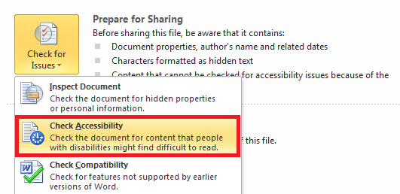
Microsoft Office 2010 Built-In Accessibility Checker
File Menu, “Check for Issues,” and then “Check Accessibility”
http://www.microsoft.com/enable/training/office2010/default.aspx

Slide 39
Adding Alt Text (Word, PPT)
Do one of the following:
For a shape, picture, chart, SmartArt graphic, or other object, right-click it, click Format object, and then click the Alt Text pane.
To add Alt Text to the entire SmartArt graphic or chart, click the border of the SmartArt graphic or chart, and not an individual shape or piece.
For a table, right-click the table, click Table Properties, and then click the Alt Text tab.
In the Description box, enter an explanation of the shape, picture, chart, table, SmartArt graphic, or other object. This box should always be filled in.
If you want, in the Title box, enter a brief summary. This box should only be filled in if you are entering a detailed or long explanation in the Description box.

Slide 40
Making Alt Text Readily Available
Using the Quick Access Toolbar (Windows Only):
In the upper-left corner above the Ribbon, click Customize Quick Access Toolbar .
Click More Commands, and then under Choose commands from click Commands Not in the Ribbon.
Click Alt Text and then click Add.
To use the Alt Text command on the Quick Access Toolbar, select the shape, picture, chart, table, SmartArt graphic, or other object, before you click the toolbar button, and then add your alternative text.

Slide 41
Applying Styles in MS Word
Changing Style Set:
On the Home tab, click Change Styles.
Point to Style Set, then hover the pointer over each style set to preview it.
Click the Word 2007 (or Word 2010) style set to apply it to the document.
Video: Applying Styles in Word 2010

Slide 42
Styling produces a Document Map for easier navigation

Slide 43
Alternative Text Examples (STEM)
NCAM – National Center for Accessible Media
Great examples of how to provide alternative text descriptions for a number of different types of STEM subject matter (e.g. scatter plots, bar graphs, diagrams, etc.
Effective Practices for Description of Science Content within Digital Talking Books

Slide 44
NCAM Example #1

Slide 45
NCAM Example #2

Slide 46
Using Adobe Reader to Check PDFs for Accessibility
Can you highlight the text?
Is the content readable?
There are some helpful accessibility features in the free Adobe PDF reader. For example, any PDF file open in Adobe reader can be read aloud with the "Read Out Loud" option.
Under the 'View' menu, select 'Read Out Loud', then 'Activate Read Out loud‘.
The Read Out Loud feature of Adobe Reader can be accessed with Keyboard Commands:
Activate Read Out Loud: Shift + Ctrl + Y
Read This Page Only: Shift + Ctrl + V
Read To End of Document: Shift + Ctrl + B
Pause/Resume: Shift + Ctrl + C
Stop: Shift + Ctrl + E

Slide 48
Contact Information
Kara Zirkle, IT Accessibility Coordinator
Address: Assistive Technology Initiative
George Mason University
4400 University Drive
MSN 6A11
Fairfax, VA 22030
Phone: 703-993-4329
Fax: 703-993-4743
Email: ati@gmu.edu
Web: http://ati.gmu.edu
Twitter: @AccessibleMason

